Slide 1
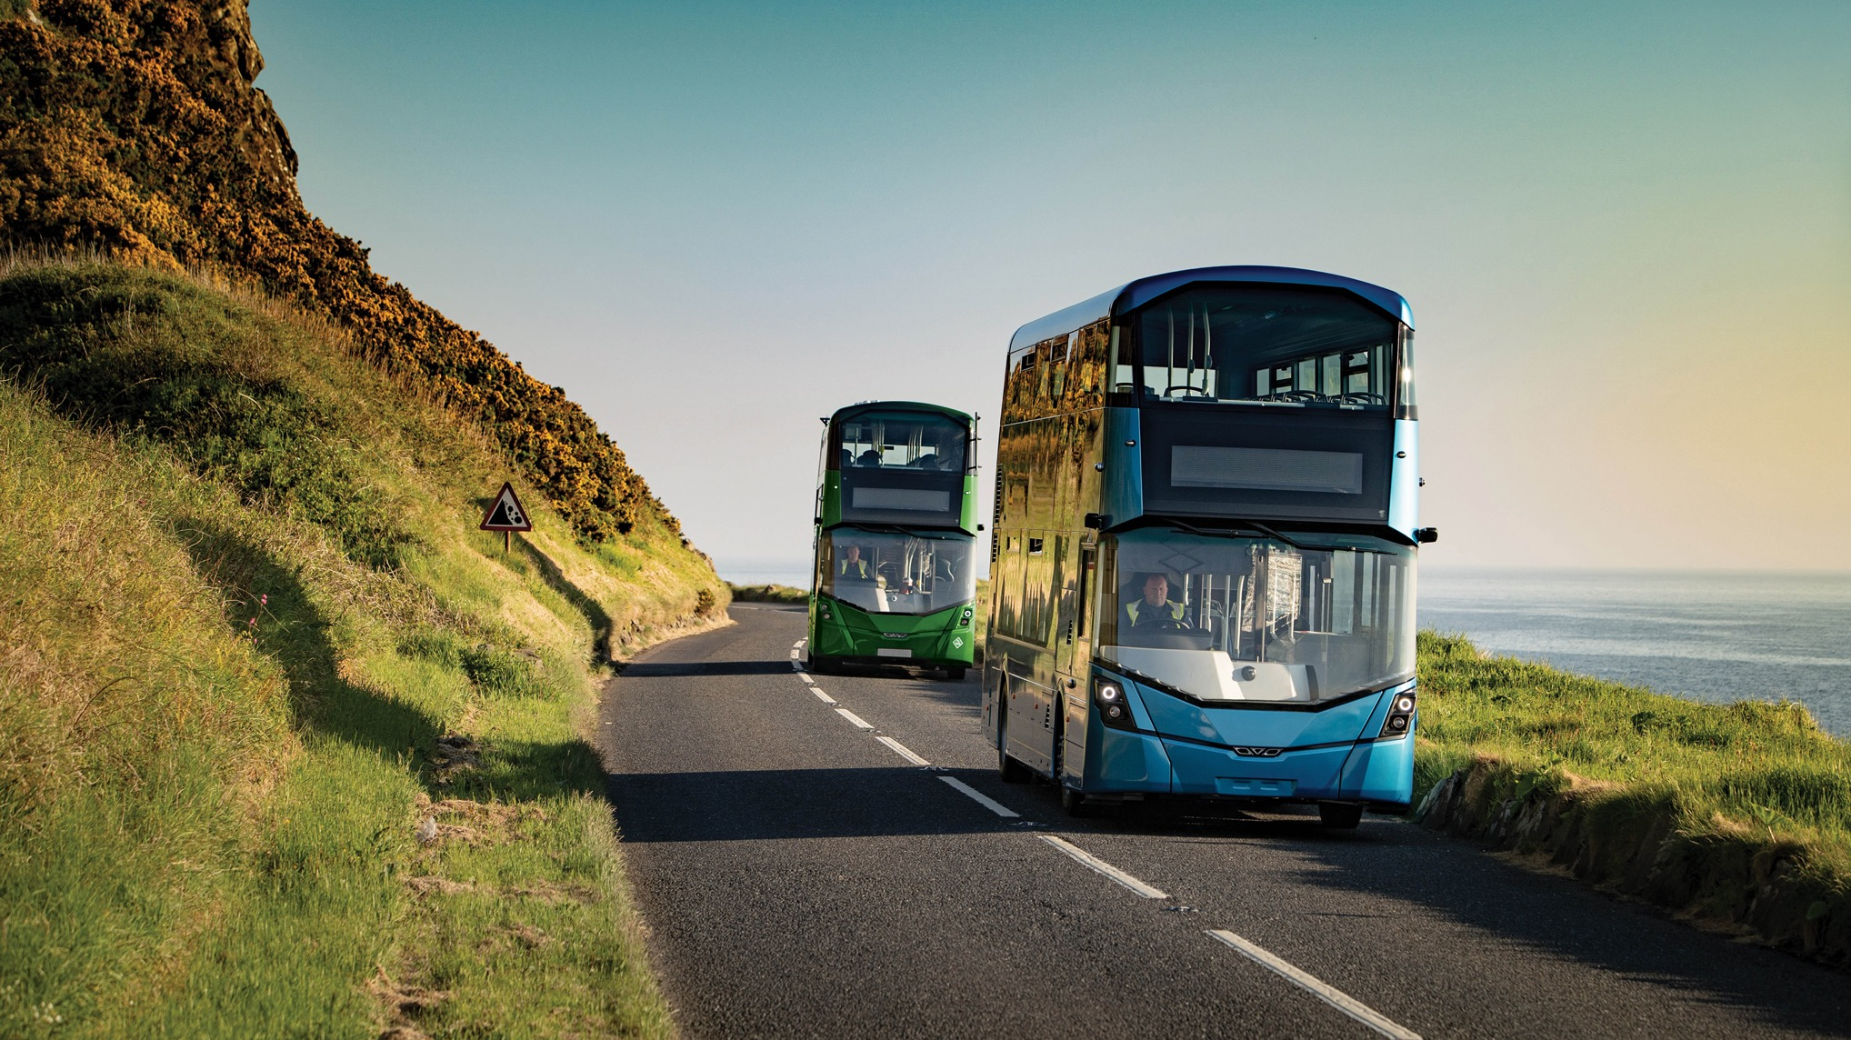

Wrightbus
Delivering a Greener Future
Tom Greenshields
Head of Business Development

Slide 2
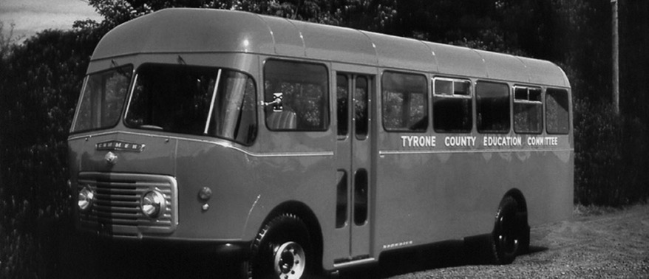

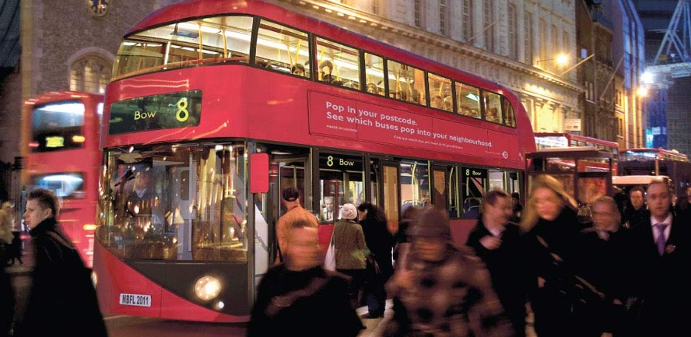
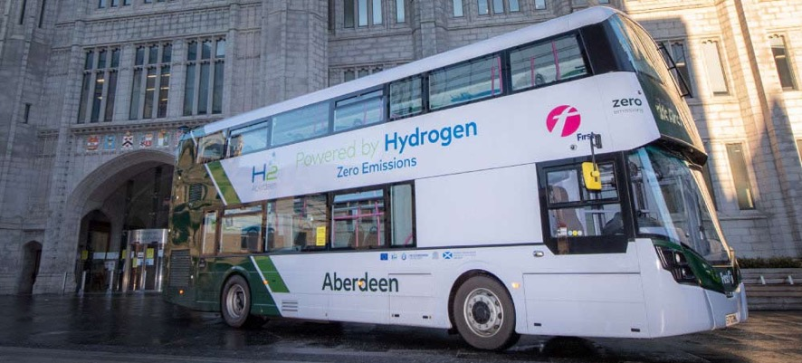
Business Overview
Feb 2022
75 Years of British Engineering Heritage
A leading industry innovator of low emission diesel, hybrid, zero-emission hydrogen and electric buses as well as the iconic new Routemaster for London
Transitioned from body only to complete manufacturer during 2007 to 2013 across the range
Relocated to a new 90 acre site (the old JTI facility) in 2018/2019 remaining in Ballymena
Future proofing capability and capacity
Business went into administration in 2019
Jo Bamford purchased the business in October 2019
Launched the world’s first hydrogen double deck vehicle October 2020

Slide 3
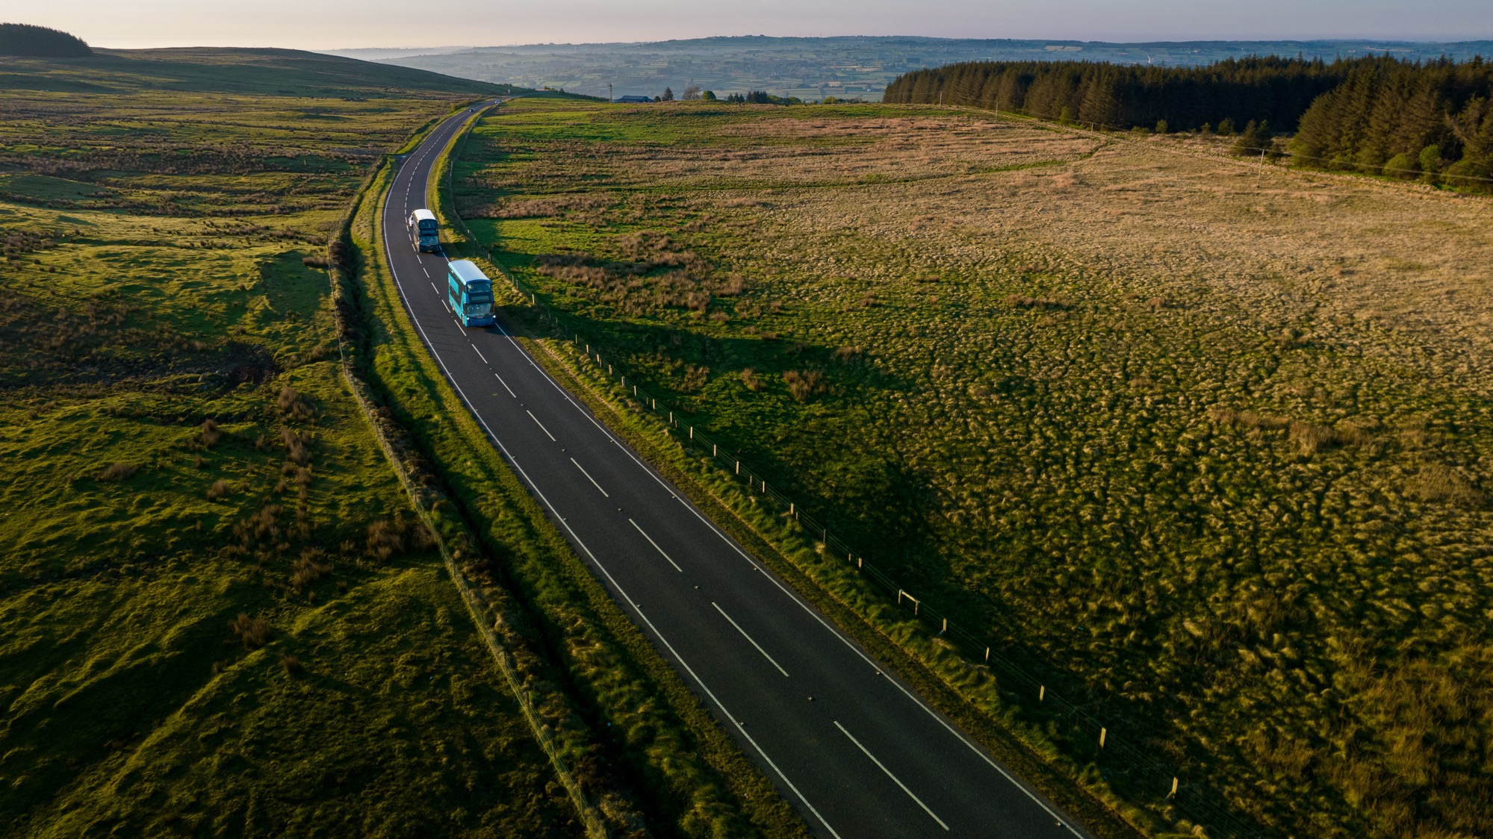
The Wrightbus Story So Far…
Since it’s inception in 1946, Wrightbus has cultivated a rich history and brand name recognized synonymously with manufacturing quality and innovation.

Slide 4
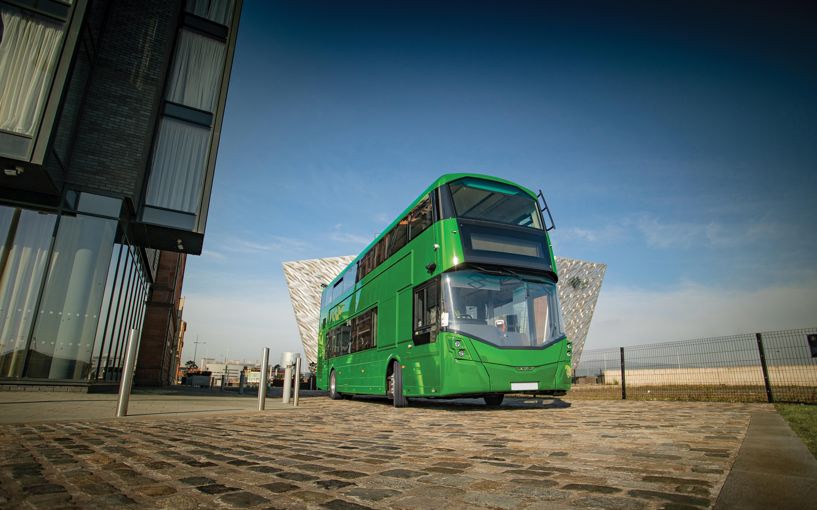
Comprehensive Zero Emission Product Offering
First mover advantage in FCEV technology, combined with a reputation for product quality has positioned Wrightbus at the centre of a rapidly developing market and ability to grow globally.

Slide 5
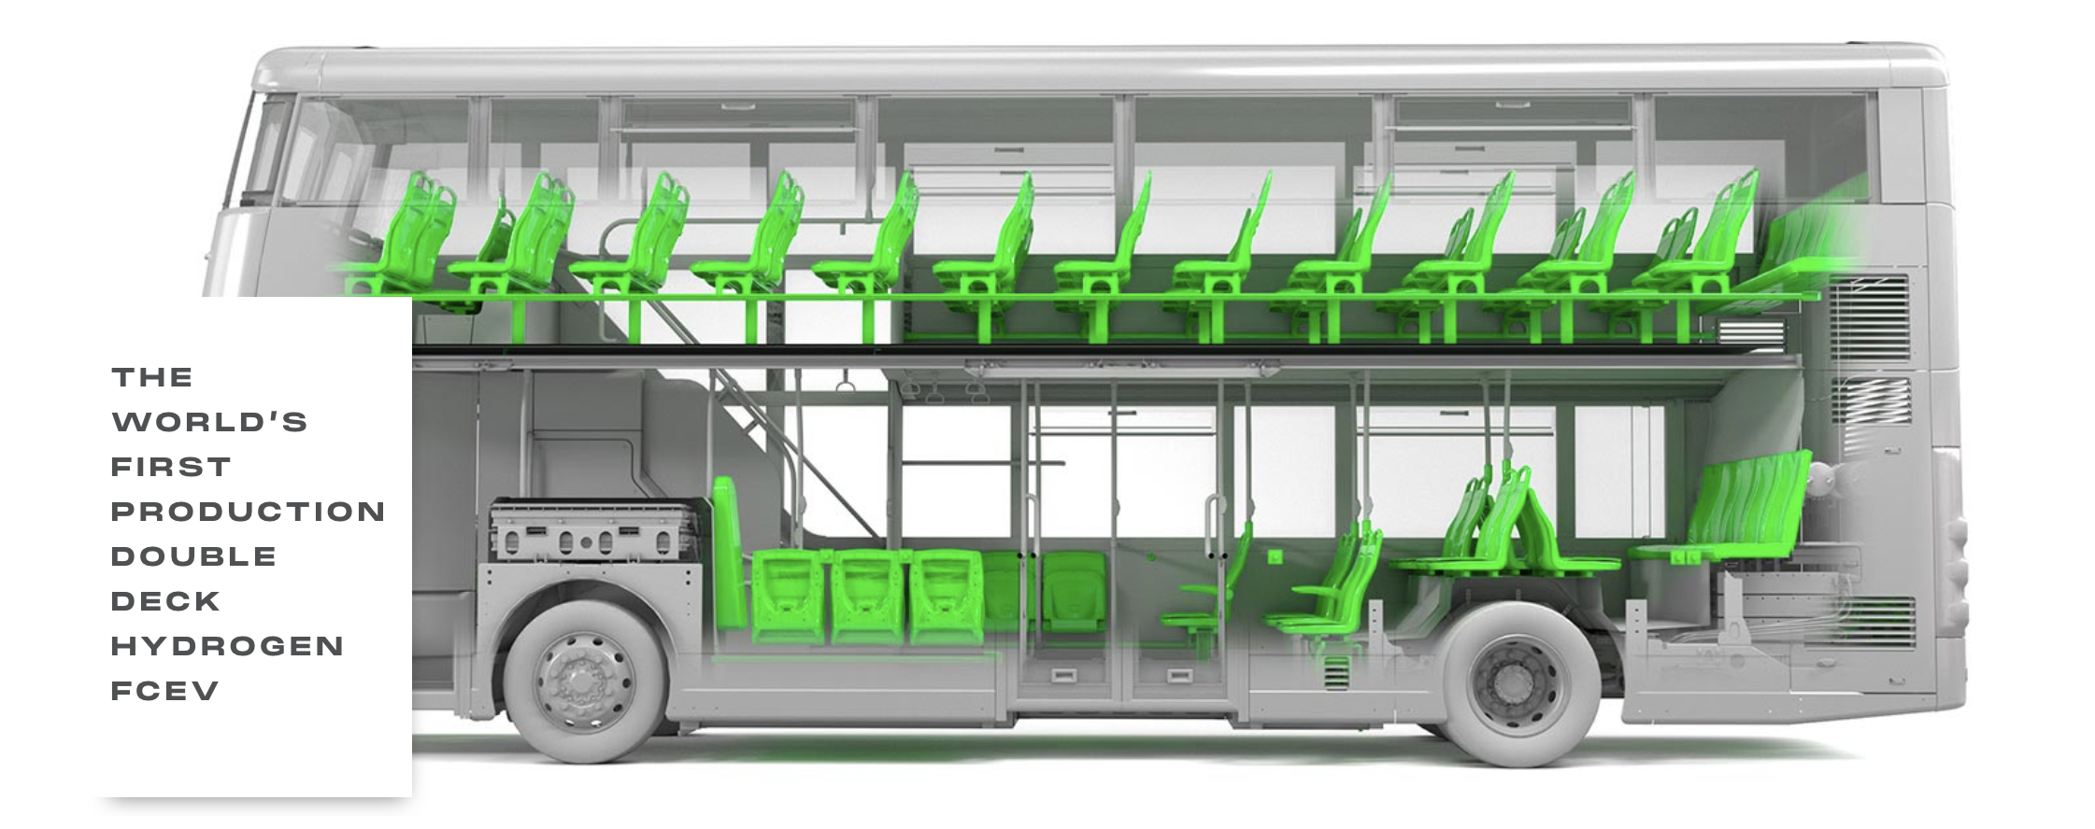
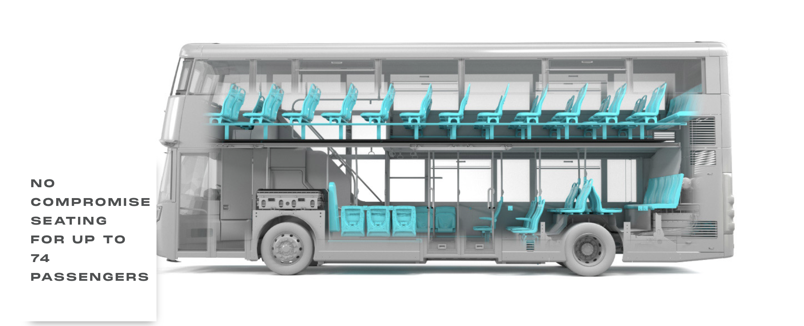
Business Overview
Comprehensive Product Offering
First mover advantage in FCEV technology, combined with a reputation for product quality has positioned Wrightbus at the centre of a rapidly developing market and ability to grow globally.
Streetdeck
Hydroliner FCEV
The world’s first hydrogen double deck bus.
Developed as part of the JIVE (Joint Initiative for Hydrogen Vehicles across Europe). Equipped with a Hydrogen Fuel Cell power train, its battery pack can store up to 48KWh and allows the bus to travel up to 300 miles
Electoliner BEV
Inspiring the next wave of electric transport
Features including modern passenger focused amenities, best in class range and charge time. The Street Deck Electroliner’s max power from a 454kW zero emission battery electric powertrain is the highest battery capacity for a UK double deck bus.

Slide 6
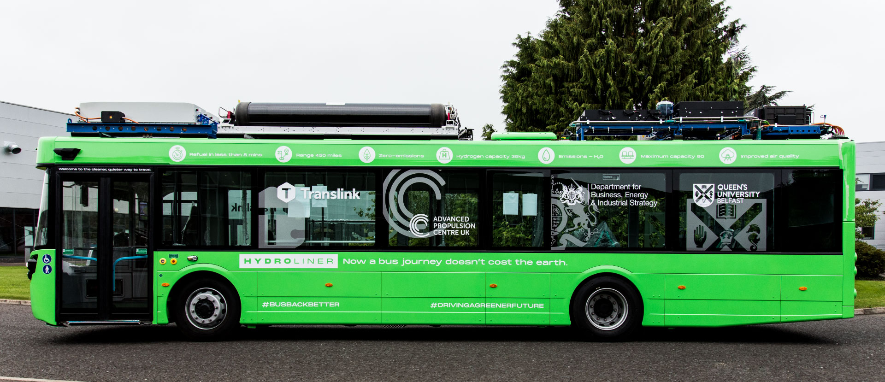
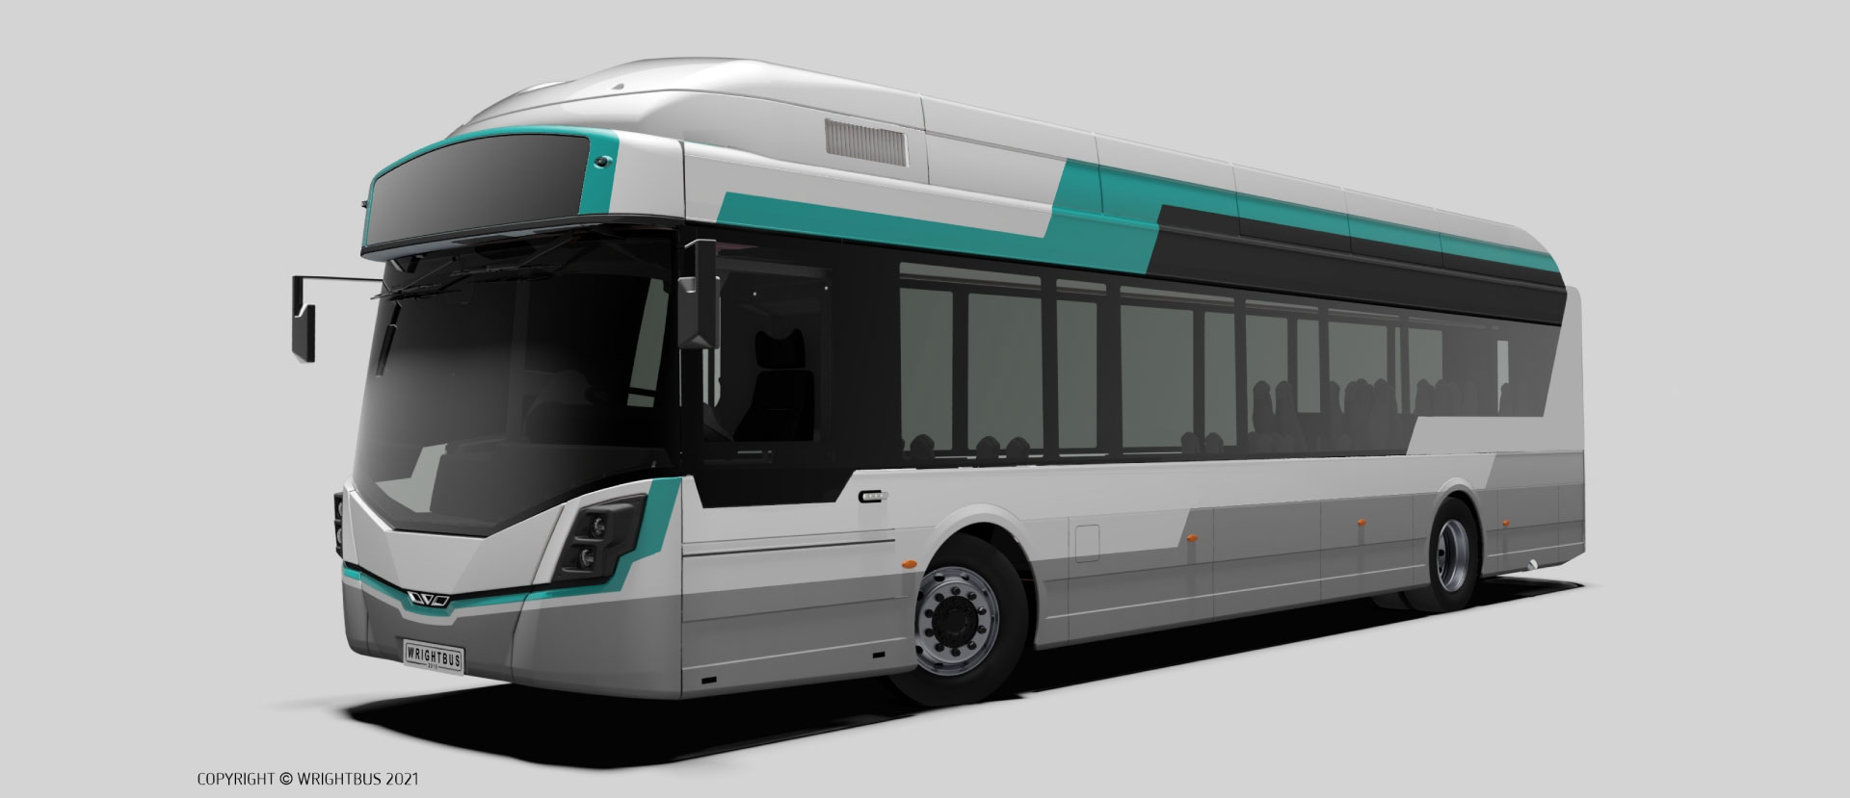
Business Overview
Comprehensive Product Offering
First mover advantage in FCEV technology, combined with a reputation for product quality has positioned Wrightbus at the centre of a rapidly developing market and ability to grow globally.
GB Kite
GB Kite Hydroliner FCEV
GB Kite Electoliner BEV
The face of environment friendly transportation
Cutting-edge features like a 2.5-hour charging time. The GB Kite Electroliner BEV has a range of up to 300 miles on a single charge, making it an excellent vehicle for intra-urban travel and a capacity of 90 passengers.
Single deck, zero emission hydrogen bus
Including fast re-fuelling time, this hydrogen-powered bus has numerous attributes that make it the ideal vehicle for long-distance travel. The GB Kite has a range of up to 500 miles and can carry up to 90 passengers.

Slide 7
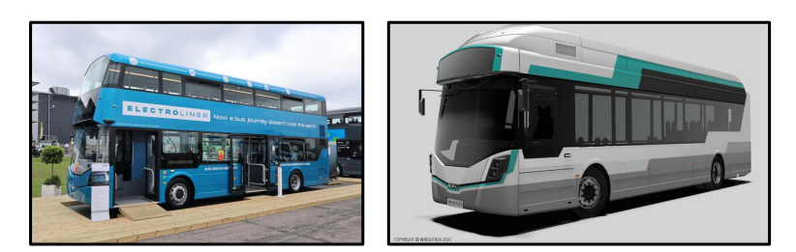
Electroliner (Battery Electric)
 | StreetDeck DD Electroliner 10.6m |  | GB Kite SD Electroliner 11.6m |  |  | GB Kite SD Electroliner 12.5m
 | 340kW | 454kW | 340kW | 454kW | 545KW | 340kW | 454kW | 545KW
Maximum Capacity | 96 | 88 | 88 | 82 | 70 | 88 | 85 | 73
Maximum Seated | 74 | 74 | Up to 34 |  |  | Up to 34 | Up to 34 | Up to 34
Range | 150miles | 200miles | 150miles | 200miles | 250miles | 150miles | 200miles | 250miles

Slide 8
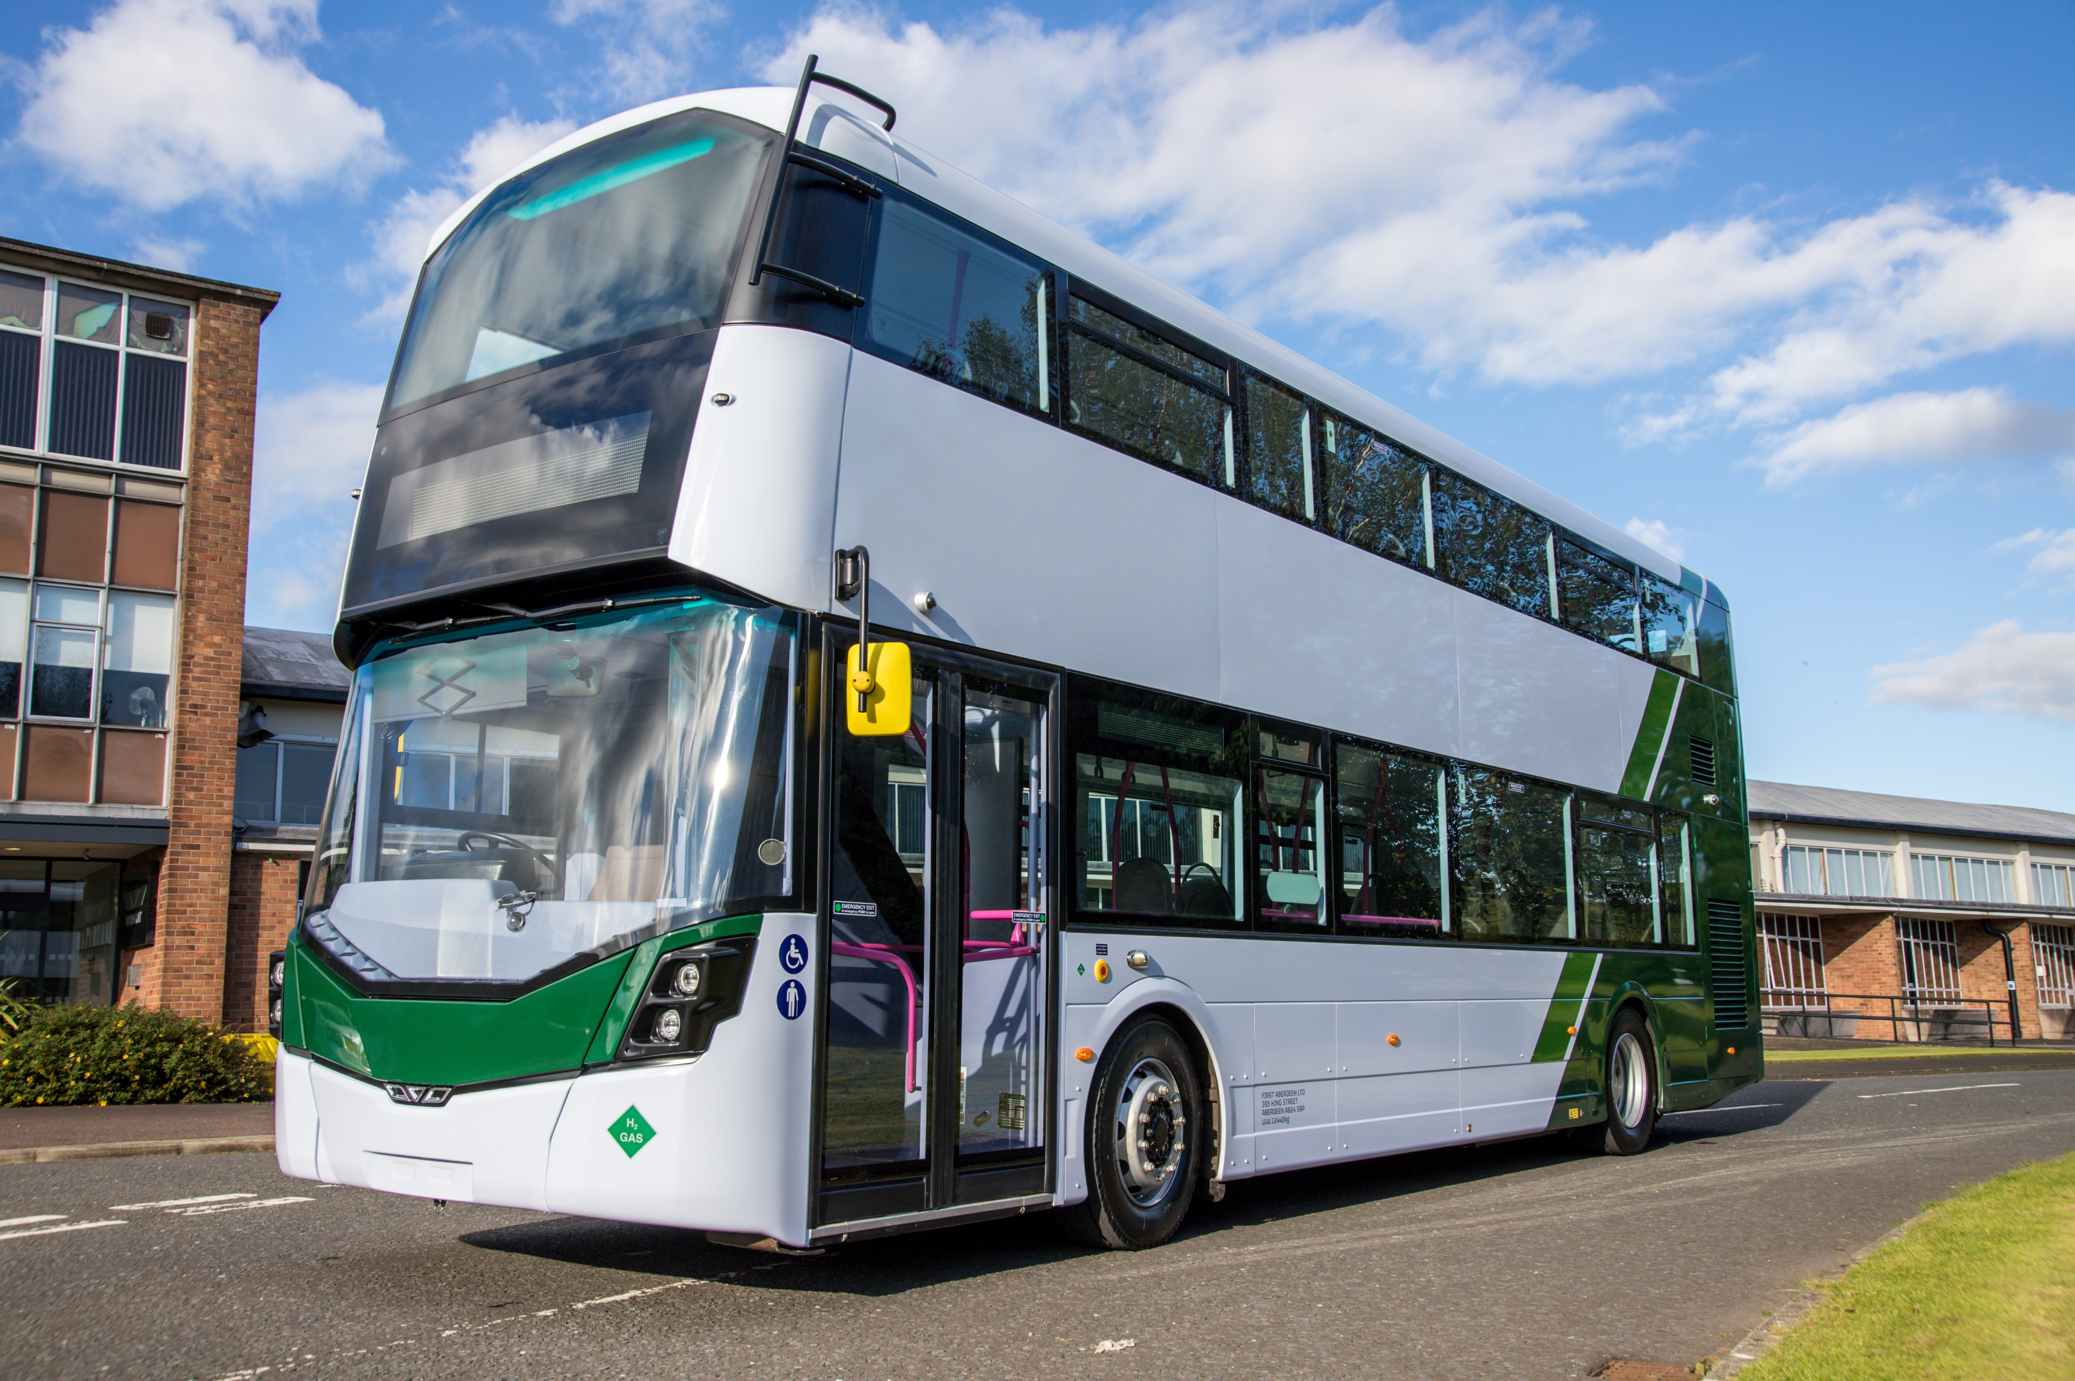

Hydroliner (Fuel Cell)
 | StreetDeck Hydroliner 10.9m | GB Kite Hydroliner 10.9m / 11.6m / 12.4m
Maximum Capacity | 86 | Up to 90
Maximum Seated | 65 | Up to 44
Range | Up to 300Miles (Specification Dependent) | Up to 500 miles (Specification Dependent)
Refuel Time | Under 8 Minutes | Under 8 Minutes

Slide 9
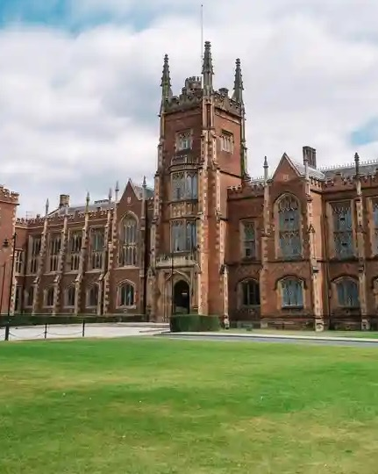

Business Overview
Queens University Belfast
Early 1990’s
Initial contact with Sir William Wright: Consulting and Engine Projects.
Early 200’s
2006
2007
2010
2017
2018
2019
2020
2021
Bamford Technology Centre
Consulting on HEV’s and Drivetrain
Funded research project: Drive cycle modelling
Hybrid modelling for 3rd generation HEV’s and New Routemaster
TSB & KTP funded projects
W-Tech Centre official opening
IDP13 and 14 funded Powertrain Projects
Renamed The Bamford Technology Centre
APC
ARMD
APC
Next Generation
FCEV
Adipiscing elit
Adipiscing elit
Adipiscing elit
24
24
24

Slide 10
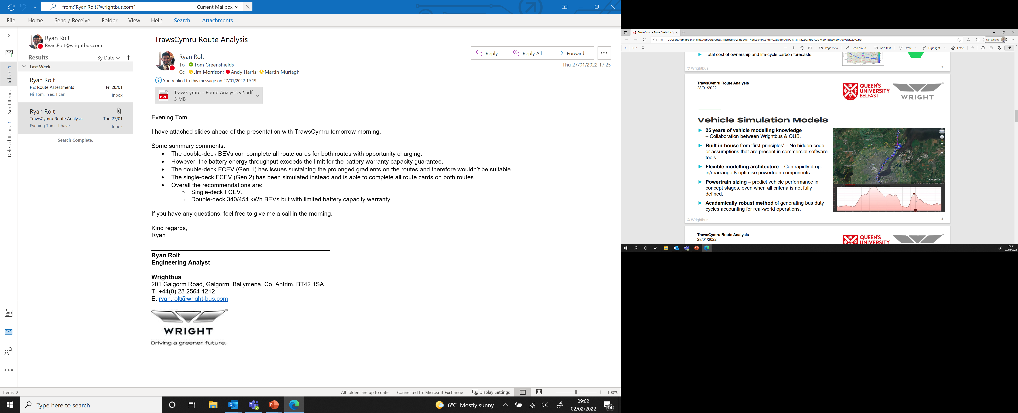

Slide 11




JCB
Ryze
Hycap
Ryze Hydrogen & full infrastructure offering
Uniquely positioned to collaborate with Ryze, a leading green hydrogen production & distribution company
Ability to offer a one stop shop solution for both bus manufacturing and supply chain for green hydrogen
Ryze currently supporting ZEBRA funding bids in collaboration with Wrightbus, with local authorities to offer a full Hydrogen solution to bus operators
This will unlock further opportunities in aftersales, providing full GB Kite Hydroliner FCEV product services for buses and supply chain
Long term capital in the clean energy sector
Bamford family committed to carbon reduction across all of their business interests
Leading the way in global hydrogen market across JCB, Wrightbus and Ryze
Long term family investor committed to delivering the business plan
Supportive of collaboration across their business interests to ensure best practice
Future potential for Wrightbus to become a “capital partner” in conjunction with Ryze and lease new bus units to operators, taking the full asset and supply chain infrastructure off balance sheet
Telematics relationship
with JCB
Ability to work closely with JCB, one of the top 3 manufacturers in the construction industry globally.
JCB have extensive experience >15 years in running full telematics services across large fleets
Wrightbus are actively working with JCB to leverage existing knowledge and expertise to quickly scale their product offering
Telematics will be key USP vs. competition in delivering the forecast plan
Further opportunities to collaborate are available with engineering and process best practices

Slide 12








FUZE LEASE & Asset MANAGEMENT – ‘ENABLING the ecosystem’
Infrastructure
Route Planning
Base Vehicle
Fuel/Power
Maintenance
Asset Management for duration of the agreement
TCO Calculation
Single monthly payment
Notes:
The pathway to a zero emission fleet involves many different stakeholders.
By acting as the conduit between these we focus on De-risking and providing the most cost effect transition process for you to introduce FCEV and BEV into your fleet.
FUZE through a collaborative approach with the various stakeholders within these sectors will provide you with a single monthly payment.
How does this actually work;
We work with you to establish cost from;
Infrastructure Providers
- Hydrogen & Battery
- Alternatively we can also liaise and partner with the battery provider of your choice
Route Planning
- Applying the results from the route analysis provided by Wrightbus we will be able to identify the optimum fleet profile and warranty requirements
This provide the optimum number of buses require
- Wrightbus for the base vehicle price
- Extended warranties
- BEV 15 Years (I am currently working on extending this further)
- FCEV 10 Years or Cost or regen and replacement batteries
In addition we can also provide;
Maintenance
- Using the data provided by route planning a maintenance cost is provided by Wrights.
- Available as Part Assurance only or Parts and Labour. This can be for part of or the total length of the lease agreement.
In addition we can at this stage provide a TCO calculation can be provided which will include;
Fuel/Power (having established through the route planning Battery 3 or 4 string or Hydrogen)
- We apply pence per km costs for either Hydrogen or Electric
Taking all or cherry picking the parts that you require (e.g you may already have the infrastructure) we are then able to provide you with a single monthly cost.
Terms are available from 7 – 21 years

Slide 13
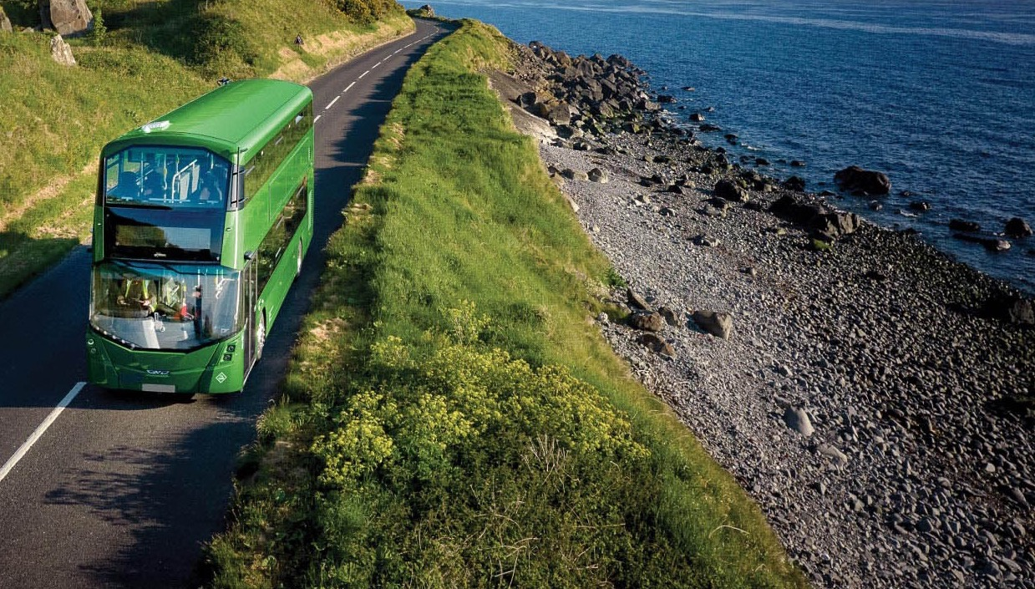




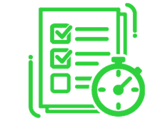
Business Overview
End to End Solution
Infrastructure and Planning
Fuel
Finance
Bus
Aftercare
Zero-emission business transformation partnership – 360 support services, for a seamless transition to the future of net zero.

Slide 14
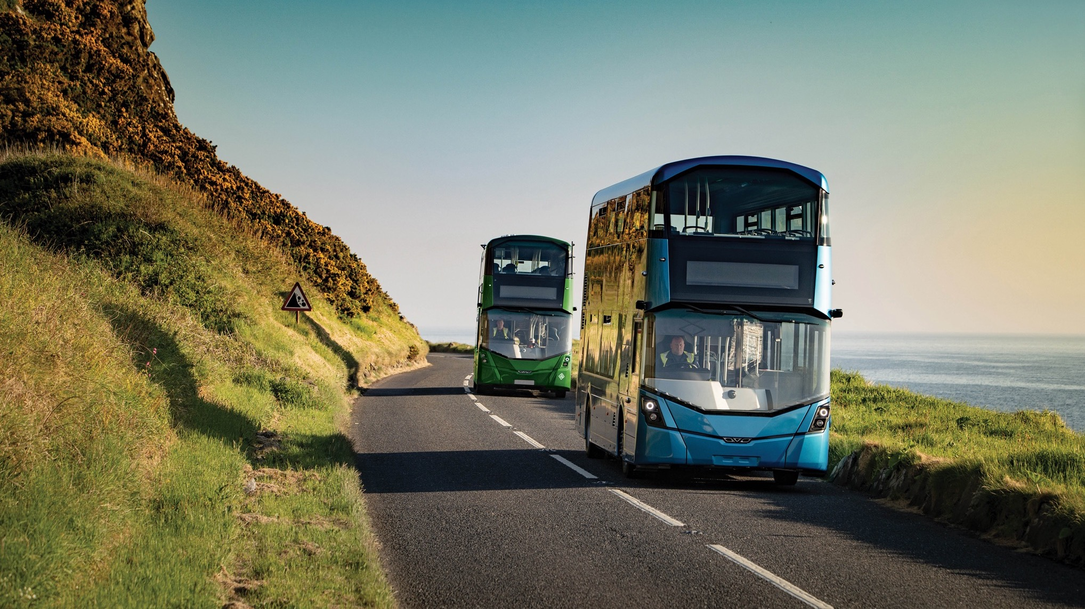
Wrightbus
Thank you.
Tom.Greenshields@wrightbus.com
07747721972

