Slide 1
Transitioning to zero emission buses
Sara Grainger, Low Carbon Economy
Transport Scotland
Sara.Grainger@transport.gov.scot

Slide 2






Not just electrification
UNSUSTAINABLE
UNSUSTAINABLE
UNSUSTAINABLE
SUB-OPTIMAL
SUB-OPTIMAL
OPTIMAL?
OPTIMAL
SUB-OPTIMAL
OPTIMAL?
UNSUSTAINABLE
SUB-OPTIMAL
OPTIMAL?
Today
EV dominated future, slow CAV and MaaS progress.
A more sustainable future

Slide 3

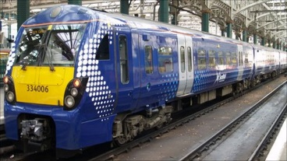
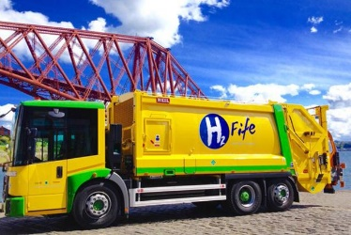
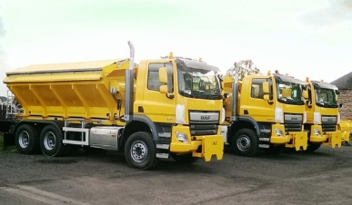
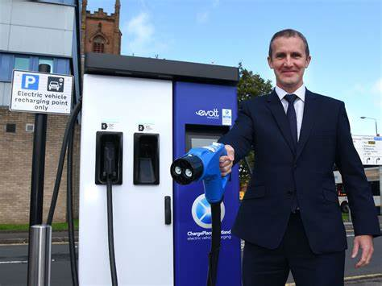
Vehicle decarbonisation
World’s first net zero aviation region by 2040
Zero emission railways by 2035
Road vehicles:
  Heavy Duty Vehicle programme
  Phase out of petrol & diesel cars by 2030
  Phase out petrol and diesel cars from public sector fleet by 2025
  Create at least 20 Electric Towns across Scotland by 2025
  Create Scotland’s first electric highway on the A9
Notes:
The task of this group also needs to be understood in the context of wider decarbonisation of all parts of Scotland’s economy, and other vehicle types in particular.
Bus are not special in this regard and Ministers have made commitments towards decarbonising domestic flights, rail, and other road vehicles.
More will be revealed when the update to the Climate Change Plan is published in December.

Slide 4
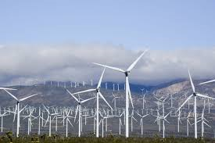
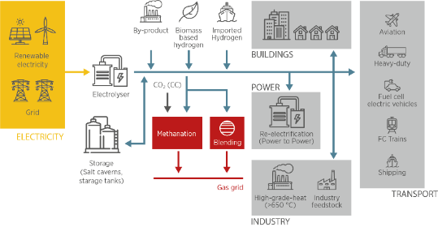

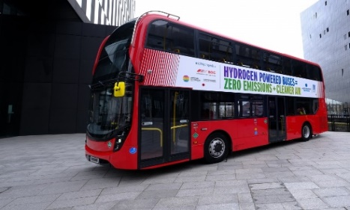
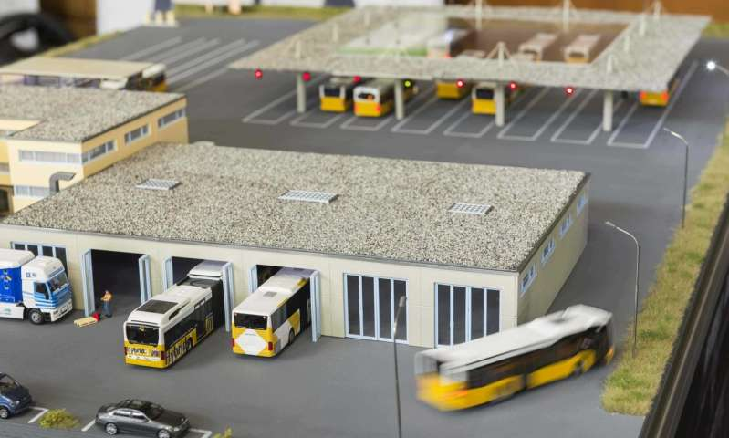
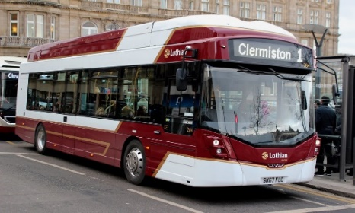
Whole system
UNSUSTAINABLE
SUB-OPTIMAL
OPTIMAL?
UNSUSTAINABLE
SUB-OPTIMAL
OPTIMAL?
Fleets can catalyse virtuous investment cycles
Collective vision and leadership
Creative investment propositions
Bold new collaborations

Slide 5
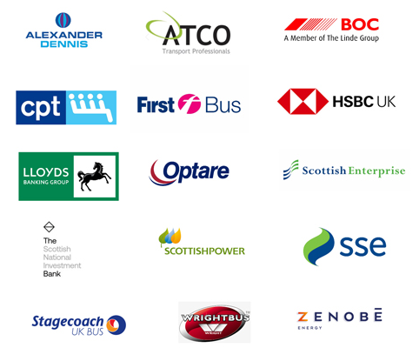
Bus Decarbonisation Taskforce
Leaders from the finance, energy, bus operating and bus manufacturing sectors
1 year, 1 task:
Co-design a vision and a pathway to a fully zero-emission bus fleet
Bus Decarbonisation Taskforce | CPT (cpt-uk.org)

Slide 6
Taskforce: OPPORTUNITIES & HURDLES
COVID19:
  passenger number impact
  green recovery
Cost & finance:
  high sticker price + installation of charging infrastructure
  high cost of hydrogen
  uncertain residual value of batteries
  uncertain maintenance costs
  lower running cost of battery-electric buses
  different financial products, incl warranties, required
Energy:
  grid capacity and processes / time / responsibility for upgrades
  supply of hydrogen & economics
Supply chain:
  range of battery electric buses & maturity of hydrogen fuel-cell buses: affordability of parts
  charging & refuelling equipment
  reuse & recycling: circular economy

Slide 7
Leading bus operators have invested >£70 million in >272 zero-emission buses
Leading bus operators are demonstrating new business models
Operators to: develop enhanced and comprehensive transition plans;
collaborate across operators (including other vehicle types) and rationalise/standardise vehicle specification;
further demonstrate and roll-out new business models designed around zero-emission buses and energy
The energy sector has largely decarbonised electricity
Hydrogen is taking off
Operators & energy companies to jointly map depots, grid capacity and hydrogen potential
Energy companies to make process more transparent, easier to navigate and quicker where possible
The finance sector have explored options and is ready to invest
New models for battery and energy infrastructure financing and ownership
Roll-out of financial products that will support zero-emission buses and infrastructure
Manufacturers and the supply chain have established zero-emission vehicles
Develop a circular economy for batteries
Innovation in batteries and fuel-cell and zero-emission vehicles continues at pace
Two-phase Scottish Zero Emission Bus Challenge Fund
Scottish Government has awarded over £50m (+£21m resource) in battery-electric buses, & several million supporting hydrogen demo projects

