Slide 1










Hitachi ZeroCarbon
New Collaborations for Zero Emission Transport
February 2022

Slide 2
HITACHI – A LEADING DRIVER IN ZERO CARBON SOLUTION DELIVERY

Slide 3
Turning the decarbonisation challenge into an opportunity for all bus operators
Supporting the Mobility & Energy Transition plan to deliver Zero Carbon fleet and depot
Charging strategy & infrastructure
Smart Charging and Telemetry Software
On-site PV & energy storage
Secondary battery management
2nd and 3rd Party charging
solution
To support e-bus depot design, configuration and deployment
To reduce OPEX by flexibly optimizing batteries, charging schedules & energy assets
To reduce electricity purchase costs and gain profit by delivering peak shaving and flexible grid services
Innovative re-use and recycle opportunities either with the bus operator or independently (taking on battery RV risk)
Generating new revenue streams by sharing available charge points to other fleet operators
Delivering a range of contracted or as a service solutions through our end-to-end technology platform

Slide 4







The Hitachi approach – Partnering the drive towards an optimal TCO operation
Sustainable long-term finance - Bridging the gap between CAPEX and OPEX, like we do for the UK rail industry with the Intercity Express Programme
Optimised operations – bringing in Hitachi Energy and key partners to optimise operations, under contract with SLAs
Optimised fleet – using our knowledge from Optimise Prime and other fleet solutions to right size your fleet.
Optimised technology solutions – An integrated platform that manages the electron from the grid to the battery
New revenue streams – through Hitachi’s ZeroCarbon Cloud and our revenue generation model for energy and community charging
New role of the fleet company in the community as an ESG player – as a COP26 principal partner Hitachi is seeking out new joint opportunities to deliver social good
Platform for growth - Supporting the development of leading eFleet and eDepot providers in the UK and beyond – out-competing the competition through optimised operations
A once in a generation opportunity to build the ‘Fleet and Depot of the Future’ and the launchpad for the next generation of business transformation

Slide 5
Delivering economies of scale to achieve a sustainable low cost model
£2499
3-5% reduction
Multiple procurement approach used at Caledonia
5-10% reduction
Building a sustainable and manageable finance platform to reduce costs of delivery and new revenue sources by delivering economies of scale and scope across:
  Contract management – one neck on the block (battery charging issue management)
  Risk management and technology innovation delivery
  Procurement of fixed and mobile assets
  Software solutions and data platform
  Renewable energy generation and arbitrage
£2299
Procuring fully integrated depots
10-15% reduction
15-25% reduction
£2099
Procuring for entire operating company as a whole
Indicative Average Cost per bus per month
£1899
£1699
Fully integrated whole fleet offer with energy trading and 3rd party charging
£1499
Fully integrated whole fleet offer with SPV finance model
£1299 and below
Piecemeal approach by depot
Integrated depot approach
economies of scale – procurement and operations
Fully integrated approach +revenue generation
Sustainable finance and integrated approach
Providing the opportunity for a ‘shared service’ approach to deliver economies of scale benefits to smaller operators

Slide 6
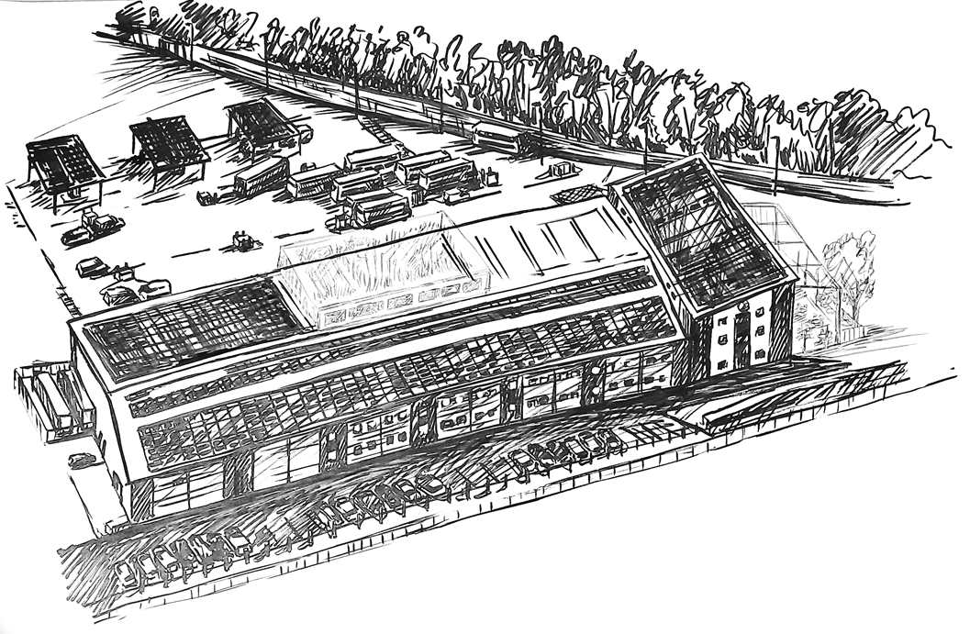
Unlocking value of electrified fleets and depots – depot of the future
eBuses and charging infrastructure
PV solar canopies
Future potential: Café & Retail
expansion (extending wallet share from charging time)
Battery storage
Private vehicle charging for employees and residents
PV solar generation
Future potential: on or over-site development for residential & commercial
2nd party charging – fleets from local businesses, government bodies, local authorities
Underpinned by a unique profit-sharing approach to new revenue generation opportunities

Slide 7


