Slide 1
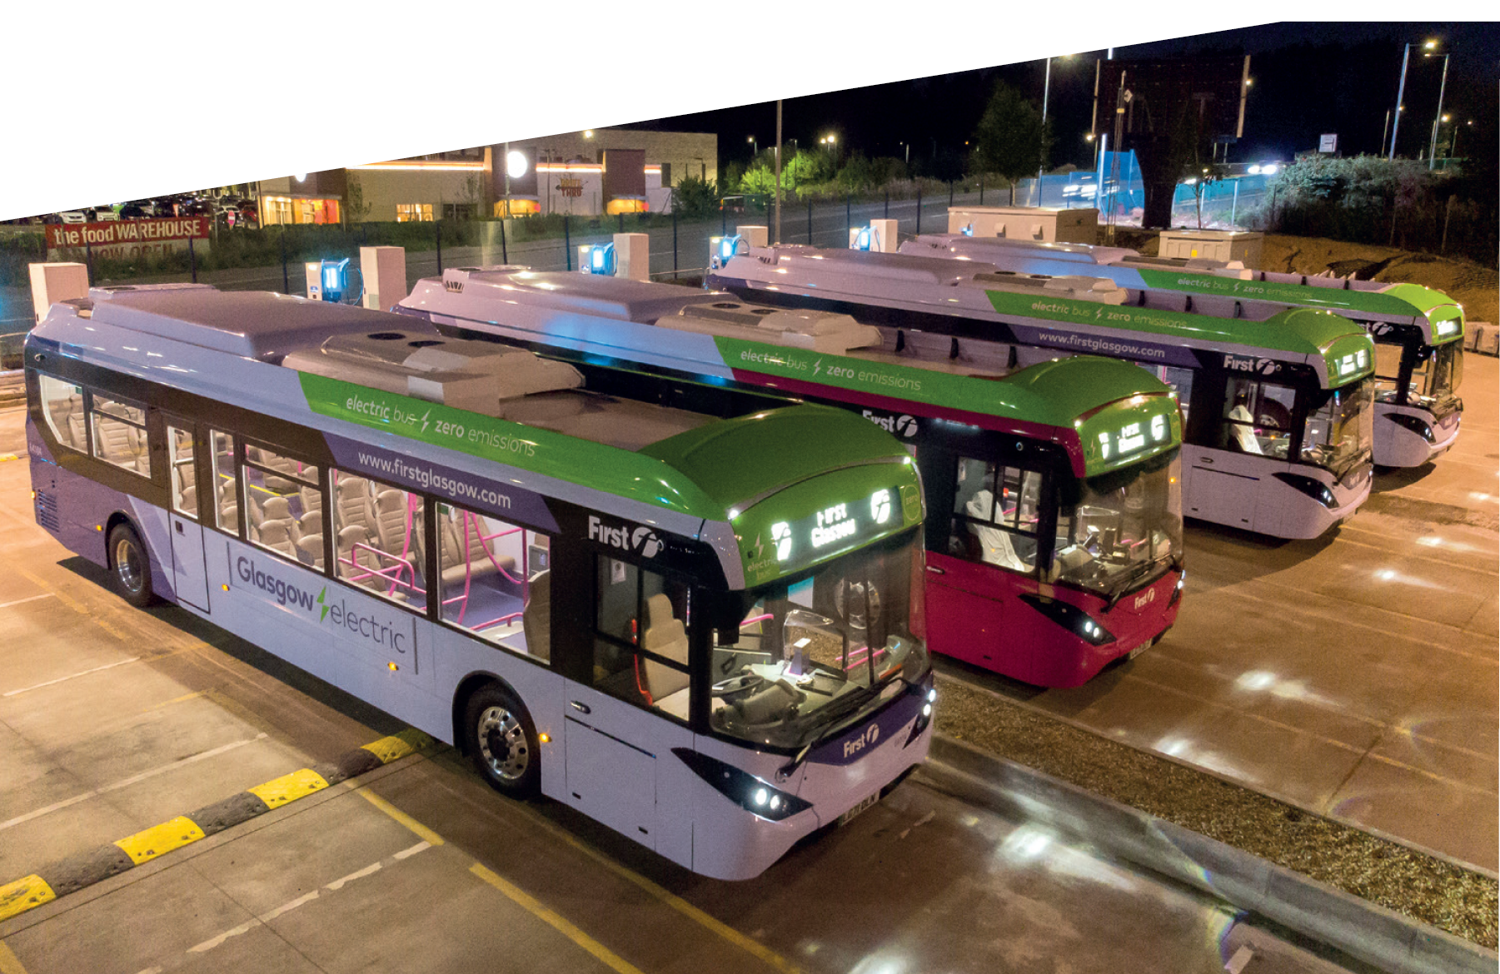


Bus Decarbonisation Workshop

Slide 2
Agenda - Bus Decarbonisation Workshop
9.30am - 9.45am Scottish Futures Trust - Welcome and Introduction – Andrew Bruce
9.45am - 10.00am Transport Scotland – A Policy Perspective – Sara Grainger
10.00am - 10.20am First Bus – An Operator Perspective – Garry Birmingham
10.20am - 10.30am Alexander Dennis – Zero Emission Bus Offering – Jamie Wilson
10.30am -10.40am Wrightbus – Zero Emission Bus Offering – Tom Greenshields
10.40am - 10.50am Scottish Power Energy Networks – How to Connect to the Grid – Jillian Violaris & John Orr
10.50am -11.10am Q&A – John Maxwell - Transport Scotland to Chair
11.10am - 11.20am Break
11.20am -11.30am Confederation of Passenger Transport – An Industry Perspective – Paul White
11.30am - 11.40am Hitachi - Financing ZE buses – Mike Nugent
11.40am - 11.50am Zenobe – Financing ZE buses – Carl Buckingham
11.50am - 12.05pm Zemo – Re-powering diesel buses and Market Statistics – Dan Hayes
12.05pm - 12.25pm Q&A – Andrew Bruce to Chair
12.25pm - 12.30pm Wrap Up - Sara Grainger – Transport Scotland

Slide 3
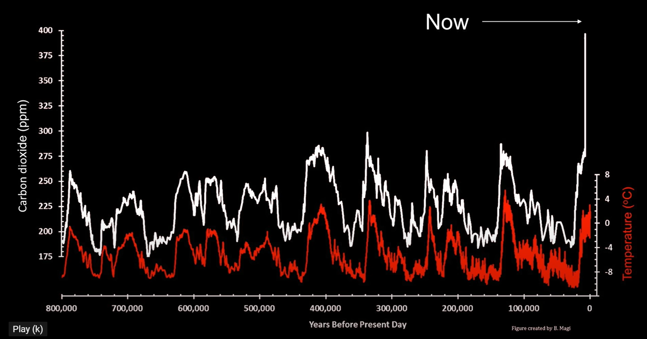

Slide 4

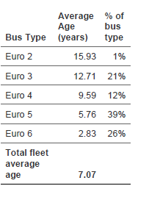
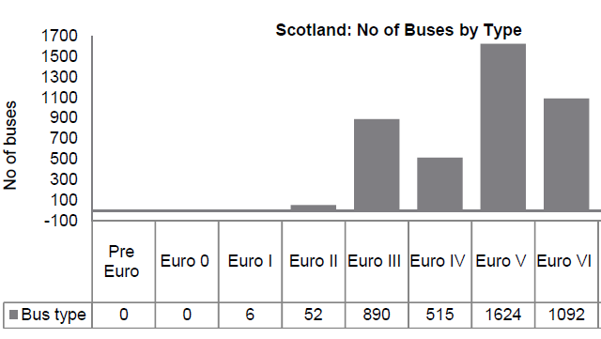
Options for decarbonisation…..
New Battery Electric
New Hydrogen Electric
Re-powering of Diesel
Source: Ernst & Young Report – Sept 2020
Available at: https://www.cpt-uk.org/news/bus-decarbonisation-taskforce/

Slide 5
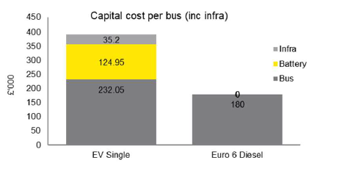
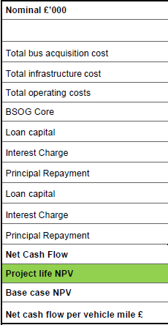
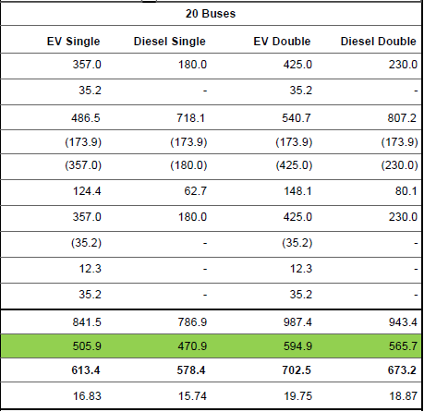
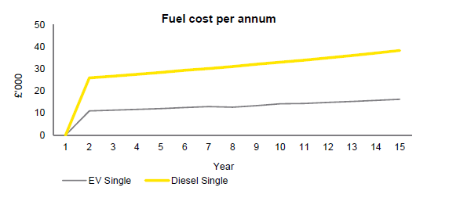
Total Cost of Ownership Battery Electric (new)
Source: Ernst & Young Report – Sept 2020
Available at: https://www.cpt-uk.org/news/bus-decarbonisation-taskforce/

Slide 6
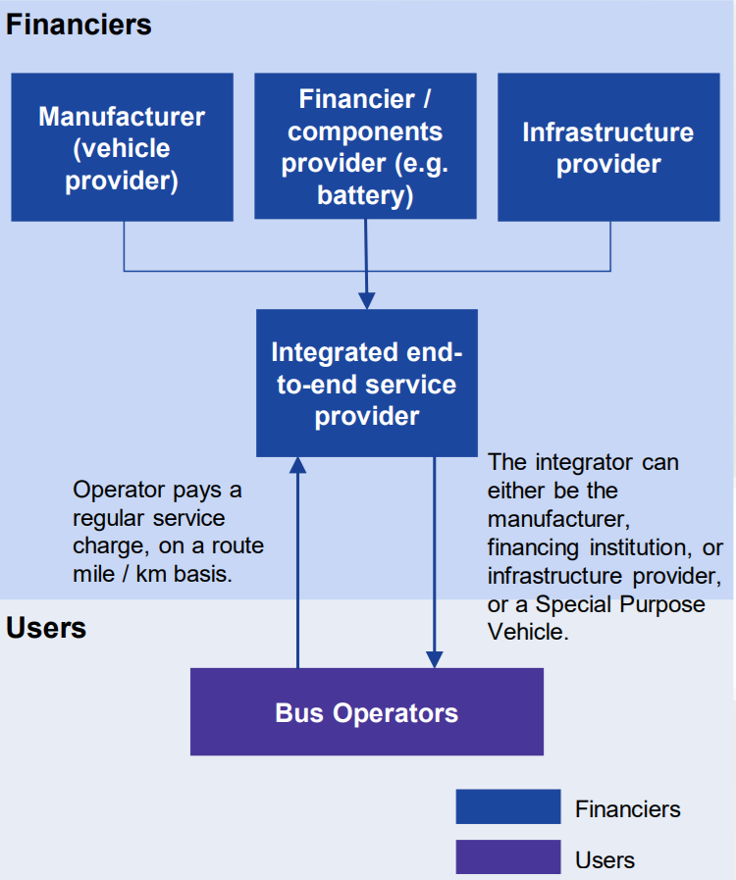
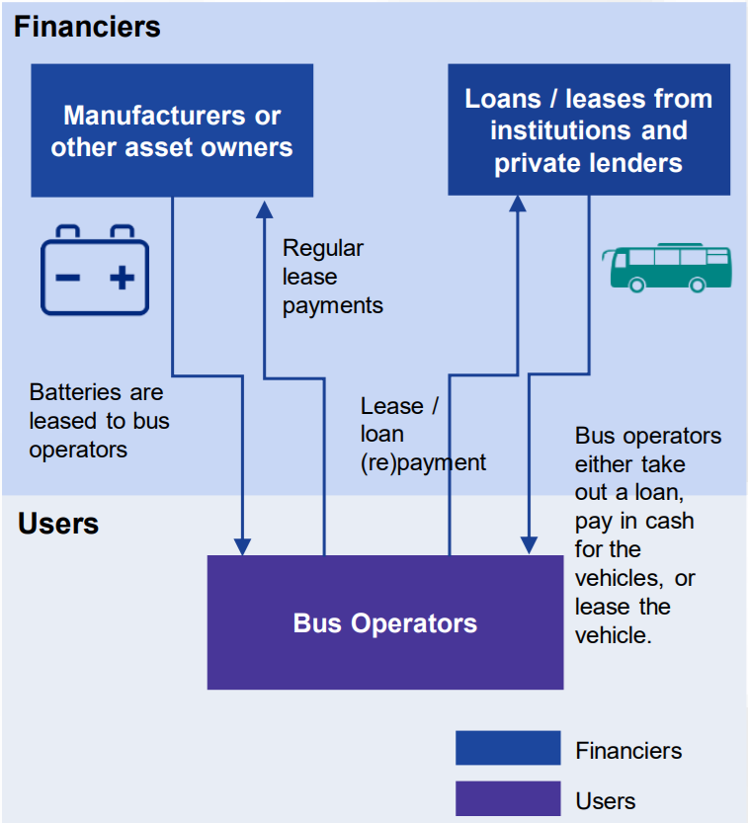
Financing (emerging) options
Source: KPMG Report – March 2021
Available at: https://www.cpt-uk.org/news/bus-decarbonisation-taskforce/

Slide 7
Contact Details
andrew.bruce@scottishfuturestrust.org.uk
Mobile: 07968 119485

